Slide 1

Natural Language Processing
Naeemullah Khan
naeemullah.khan@kaust.edu.sa
KAUST Academy
King Abdullah University of Science and Technology

Slide 2
N-grams
An N-gram is a sequence of N words
Corpus: because I am learning
I | am | happy
Unigrams: {
I
, am , happy , because , learning }
Bigrams: {
I am
, am happy , happy because … }
I happy
Trigrams: { I am happy , am happy because, … }

Slide 3









Sequence Notation
Corpus:
This is great
…
teacher drinks tea.

Slide 4
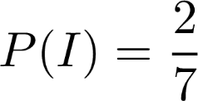
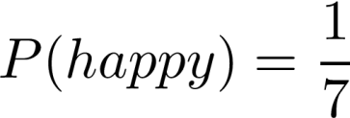
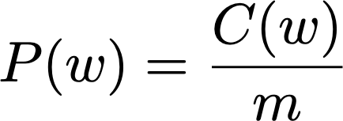
Unigram probability
Corpus:
I
am
happy
because I am learning
Size of corpus m = 7
Probability of unigram:

Slide 5

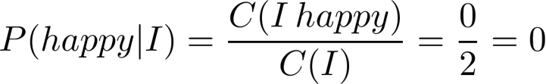
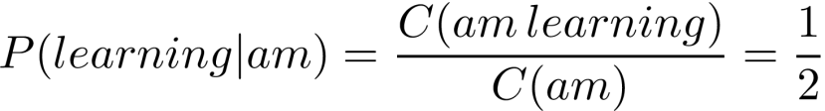
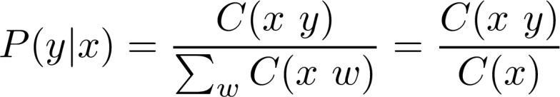
Bigram Probability
Corpus: I am happy becaus
e I | am | learning
I happy
Probability of a bigram:

Slide 6
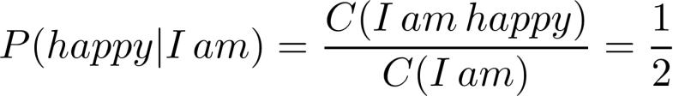
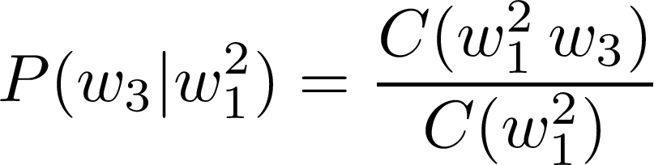
Trigram Probability
Corpus: I am happy because
I am
learning
Probability of a trigram:

Slide 7
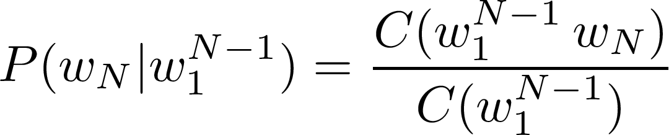

N-gram Probability
Probability of N-gram:

Slide 8
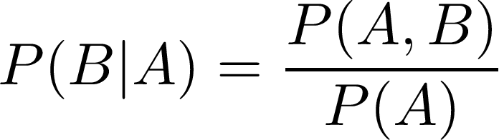

Probability of a sequence
Given a sentence, what is its probability?
?
Conditional probability and chain rule reminder

Slide 9
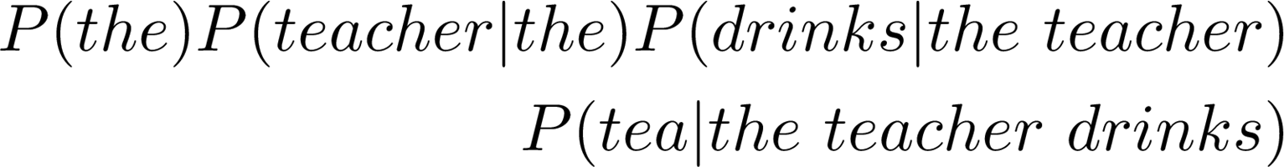
Probability of a sequence

Slide 10
Sentence not in corpus
Problem: Corpus almost never contains the exact sentence we’re
interested in or even its longer subsequences!
Input: the teacher drinks tea
Both likely 0

Slide 11



Approximation of sequence probability
the teacher drinks tea

Slide 12
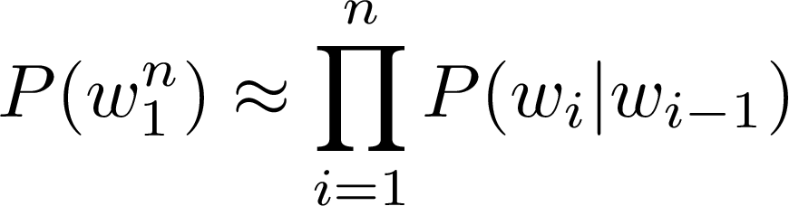
Approximation of sequence probability
Markov assumption: only last N words matter
Bigram
N-gram
Entire sentence modeled with bigram

Slide 13
Quiz
Objective: Apply sequence probability approximation with bigrams.
Question:
Given these conditional probabilities
P(Mary)=0.1;
P(Mary|likes) =0.2;
P(likes)=0.2; P(likes|Mary) =0.3;
P(cats)=0.3
P(cats|likes)=0.1; P(likes|cats)=0.4
Approximate the probability of the following sentence with bigrams: “Mary likes cats”
Type: Multiple Choice, single answer
Options and solution:
1. P(Mary likes cats) = 0
2.
P(Mary likes cats) =1
3. P(Mary likes cats) = 0.003
4.
P(Mary likes cats) = 0.008

Slide 14
Starting and Ending Sentences
Start of sentence symbols <s>
End of sentence symbol </s>

Slide 15
Start of sentence token <s>
the
teacher drinks tea
<s> the
teacher drinks tea

Slide 16
Start of sentence token <s> for N-grams
Trigram:
the teacher drinks tea => <s> <s> the teacher drinks tea
N-gram model: add N-1 start tokens <s>

Slide 17
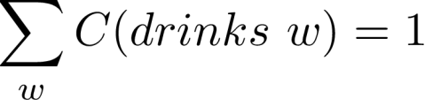

End of sentence token </s> - motivation
Corpus:
<s> Lyn
<s> John
drinks |  | chocolate
 | drinks

Slide 18







End of sentence token </s> - motivation
Corpus
<s> yes no
<s> yes yes
<s> no no
Sentences of length 2:
<s> yes yes
<s> yes no
<s> no no
<s> no yes

Slide 19




End of sentence token </s> - motivation
Corpus
<s> yes no
<s> yes yes
<s> no no
Sentences of length 2:
<s> yes yes
<s> yes no
<s> no no
<s> no yes

Slide 20




End of sentence token </s> - motivation
Sentences of length 3:
<s> yes yes yes
<s> yes yes no
…
<s> no no no
Corpus
<s> yes no
<s> yes yes
<s> no no

Slide 21
End of sentence token </s> - motivation
Corpus
<s> yes no
<s> yes yes
<s> no no

Slide 22
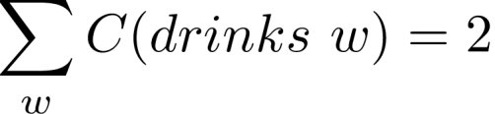
End of sentence token </s> - solution
Bigram
<s> the teacher drinks tea =>
<s> the teacher drinks tea </s>
Corpus:
<s> Lyn drinks chocolate
<s> John drinks </s>
</s>

Slide 23
End of sentence token </s> for N-grams
N-gram => just one </s>
E.g. Trigram:
the teacher drinks tea => <s> <s> the teacher drinks tea </s>

Slide 24
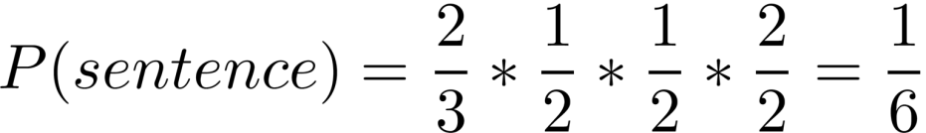
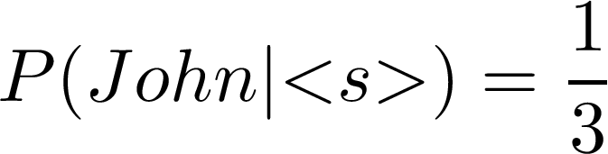
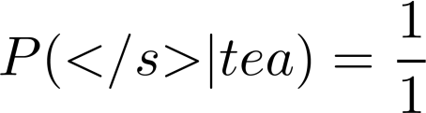
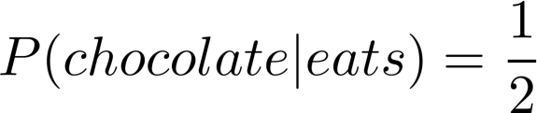


Example - bigram
Corpus
<s> John drinks tea </s>
<s> Lyn eats chocolate </s>
<s> | Lyn | drinks | chocolate | </s>

Slide 25
Quiz
Objective: Apply sequence probability approximation with bigrams after adding start and end word.
Question:
Given these conditional probabilities
P(Mary)=0.1;
P(Mary|<s>)=0.2;
P(likes|Mary) =0.3;
P(likes)=0.2; P(</s>|cats)=0.6 P(cats|likes)=0.1
P(cats)=0.3
Approximate the probability of the following sentence with bigrams: “<s> Mary likes cats </s>”
Type: Multiple Choice, single answer
Options and solution:
2. P(<s> Mary likes cats </s>) =0.0036
1. P(<s> Mary likes cats </s>) = 0
3. P(<s> Mary likes cats </s>) = 0.003
4. P(<s> Mary likes cats </s>) = 1

Slide 26
The N-gram Language Model
Count matrix
Probability matrix
Language model
Log probability to avoid underflow
Generative language model

Slide 27
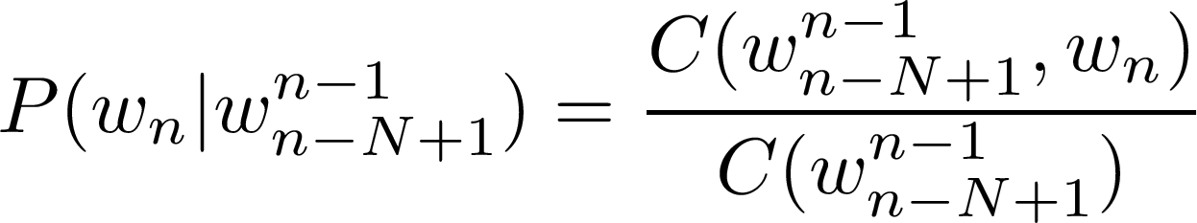
Count Matrix
Rows: unique corpus (N-1)-grams
Columns: unique corpus words
Corpus: <s>I study I learn</s>
Bigram
count matrix
 | <s> | </s> | I | study | learn
<s> | 0 | 0 | 1 | 0 | 0
</s> | 0 | 0 | 0 | 0 | 0
I | 0 | 0 | 0 | 1 | 1
study | 0 | 0 | 1 | 0 | 0
learn | 0 | 1 | 0 | 0 | 0
“study I” bigram

Slide 28

Probability Matrix
Divide each cell by its row sum
Corpus: <s>I study I learn</s> Count matrix (bigram)
Probability matrix
 | <s> | </s> | I | study | learn | sum
<s> | 0 | 0 | 1 | 0 | 0 | 1
</s> | 0 | 0 | 0 | 0 | 0 | 0
I | 0 | 0 | 0 | 1 | 1 | 2
study | 0 | 0 | 1 | 0 | 0 | 1
learn | 0 | 1 | 0 | 0 | 0 | 1
 | <s> | </s> | I | study | learn
<s> | 0 | 0 | 1 | 0 | 0
</s> | 0 | 0 | 0 | 0 | 0
I | 0 | 0 | 0 | 0.5 | 0.5
study | 0 | 0 | 1 | 0 | 0
learn | 0 | 1 | 0 | 0 | 0

Slide 29
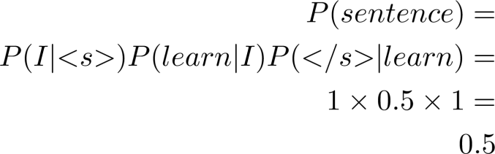
Language Model
probability matrix => language model
Sentence probability
Next word prediction
 | <s> | </s> | I | study | learn
<s> | 0 | 0 | 1 | 0 | 0
</s> | 0 | 0 | 0 | 0 | 0
I | 0 | 0 | 0 | 0.5 | 0.5
study | 0 | 0 | 1 | 0 | 0
learn | 0 | 1 | 0 | 0 | 0
Sentence probability:
<s> I learn </s>

Slide 30
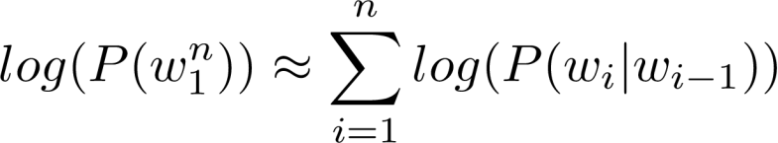
Log probability
All probabilities in calculation <=1 and multiplying them brings risk
of underflow
Logarithm properties reminder
Use log of the probabilities in Probability matrix and calculations
Converts back from log

Slide 31
Generative Language model
Corpus:
<s> Lyn drinks chocolate </s>
<s> John drinks tea </s>
<s> Lyn eats chocolate </s>
1.
(<s>, Lyn)
or (<s>, John)?
2. (Lyn,eats) or
(Lyn,drinks)
?
3.
4.
(drinks,tea)
or (drinks,chocolate)?
(tea,</s>)
- always
Algorithm:
Choose sentence start
Choose next bigram starting with previous word
Continue until </s> is picked

Slide 32
Quiz
Objective: Apply sum when calculating log probability instead of product.
Question:
Given the logarithm of these conditional probabilities:
log(P(Mary|<s>))=-2; log(P(</s>|cats))=-1 log(P(likes|Mary)) =-10; log(P(cats|likes))=-100
Approximate the log probability of the following sentence with bigrams : “<s> Mary likes cats </s>”
Type: Multiple Choice, single answer
Options and solution:
1. log(P(<s> Mary likes cats </s>)) = -113
2.
log(P(<s> Mary likes cats </s>)) =2000
3. log(P(<s> Mary likes cats </s>)) = 113
4.
log(P(<s> Mary likes cats </s>))= -112

Slide 33
Language Model Evaluation
Train/Validation/Test split
Perplexity

Slide 34
Test data
Split corpus to Train/Validation/Test
Evaluate on Training dataset
For smaller corpora
80% Train
10% Validation
10% Test
For large corpora (typical for text)
98% Train
1% Validation
1% Test

Slide 35
Test data - split method
Continuous text
Random short sequences
Test
Validation
Training
Corpus

Slide 36


Perplexity
W → test set containing m sentences s
* i-th sentence in the test set, each ending with </s>
m → number of all words in entire test set W including
</s> but not including <s>

Slide 37
Perplexity
E.g. m=100
Smaller perplexity = better model
Character level models PP < word-based models PP

Slide 38
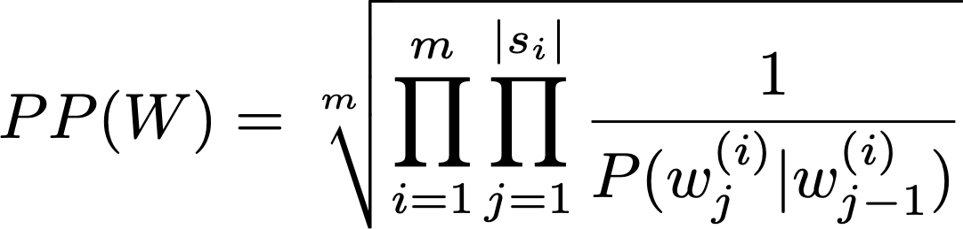

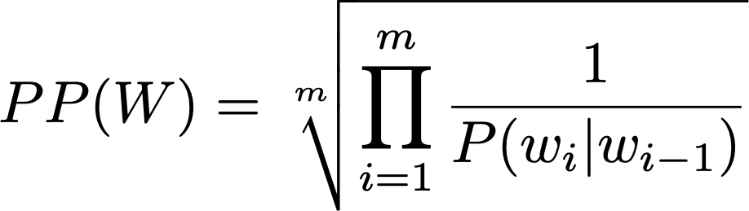

Perplexity for bigram models
* j-th word in i-th sentence
concatenate all sentences in W
* i-th word in test set

Slide 39
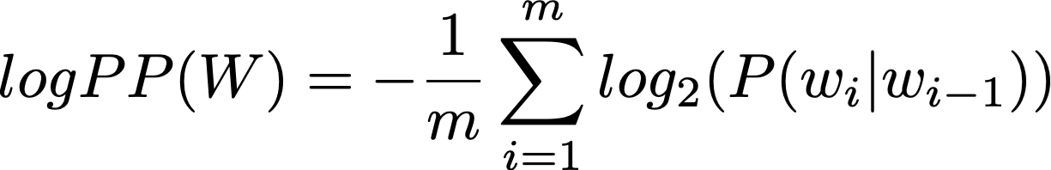
Log Perplexity

Slide 40
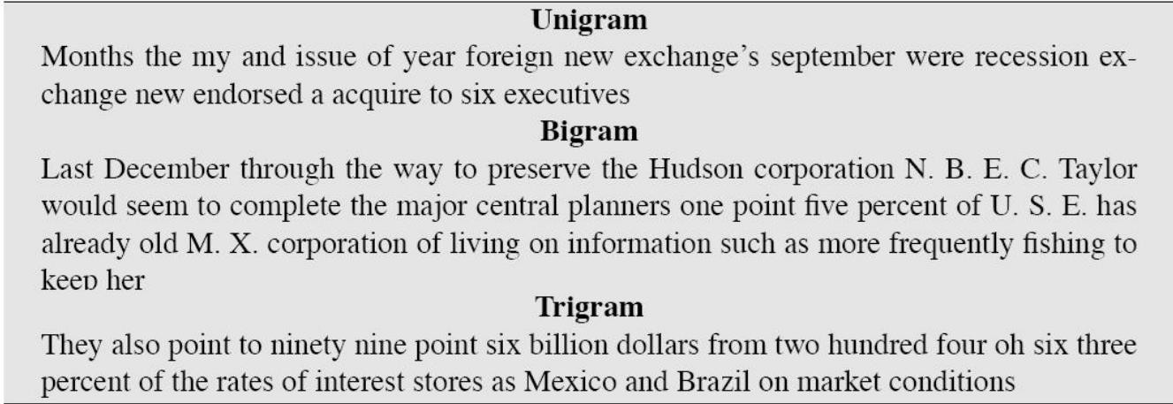
Perplexity - Example
Training 38 million words, test 1.5 million words, WSJ corpus
Perplexity Unigram: 962 Bigram: 170 Trigram: 109
[Figure from Speech and Language Processing by Dan Jurafsky et. al]

Slide 41
Perplexity - Example
Objective: Calculate log perplexity from log probabilities using sum and correct normalization coefficient (not including <s>).
Question:
Given the logarithm of these conditional probabilities: log(P(Mary|<s>))=-2; log(P(</s>|cats))=-1 log(P(likes|Mary)) =-10; log(P(cats|likes))=-100
Assuming our test set is W=“<s> Mary likes cats </s>”, what is the model’s perplexity.
Type: Multiple Choice, single answer
Options and solution:
1. log PP(W) = -113
3. log PP(W) = (-1/5)*(-113)
2. log PP(W) = (-1/4)*(-113)
4. log PP(W) = (-1/5)*113

Slide 42
Out of vocabulary words
Closed vs. Open vocabularies
Unknown word = Out of vocabulary word (OOV)
special tag <UNK> in corpus and in input

Slide 43
Using <UNK> in corpus
Create vocabulary V
Replace any word in corpus and not in V by <UNK>
Count the probabilities with <UNK> as with any other word

Slide 44
Example
Corpus
<s> Lyn drinks chocolate </s>
<s> John drinks tea </s>
<s> Lyn eats chocolate </s>
Corpus
<s> Lyn drinks chocolate </s>
<s> <UNK> drinks <UNK> </s>
<s> Lyn <UNK> chocolate </s>
Min frequency f=2
Input query
Vocabulary
Lyn, drinks, chocolate
<s>Adam drinks chocolate</s>
<s><UNK> drinks chocolate</s>

Slide 45
How to create vocabulary V
Criteria:
Min word frequency f
Max |V|, include words by frequency
Use <UNK> sparingly
Perplexity - only compare LMs with the same V

Slide 46
Missing N-grams in training corpus
Problem: N-grams made of known words still might be missing in
the training corpus
“John” , “eats” in corpus “John eats”
Their counts cannot be used for probability estimation
Can be 0

Slide 47
Smoothing
Advanced methods: Kneser-Ney smoothing Good-Turing smoothing
Add-one smoothing (Laplacian smoothing)
Add-k smoothing

Slide 48
Backoff
If N-gram missing => use (N-1)-gram, …
Probability discounting e.g. Katz backoff
“Stupid” backoff
Corpus
<s> Lyn drinks chocolate </s>
<s> John drinks tea </s>
<s> Lyn eats chocolate </s>

Slide 49
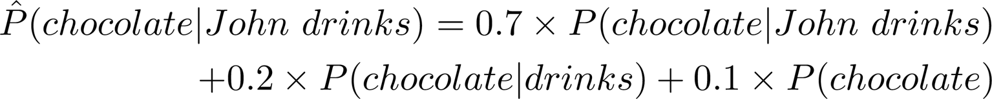
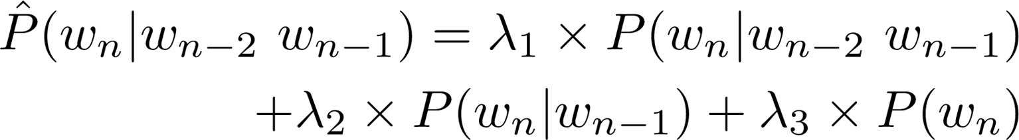
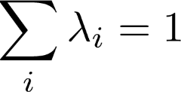
Interpolation

Slide 50
References
These slides have been adapted from
Younes Mourri & Lukasz Kaiser, Natural Language Processcing Specialization, DeepLearning.Ai

